Slide 1


Sap ABAP on Hana &
s/4hana trainings
Anubhav Oberoy

Slide 2

INTRODUCTION

Slide 3
Agenda – Day 4
Creation and execution of Data Models
Showing Concept of currency conversion
Concept of Dimensions and Measures
Implementing OIA Using Calculation View
Concept of Delivery Unit
--Break--
Consume HANA Objects
ADBC ( ABAP Database Connectivity )
View Proxy
Transporting of Dependent Objects
Lifecycle Management
HANA Transport Container

Slide 4
Agenda – Day 4
SQL Script
Declarative Logic
Imperative Logic
Making Data Flow Graph
Containers
Anonymous Block
Stored Procedure
User-defined function
Scaler UDF
Table UDF

Slide 5
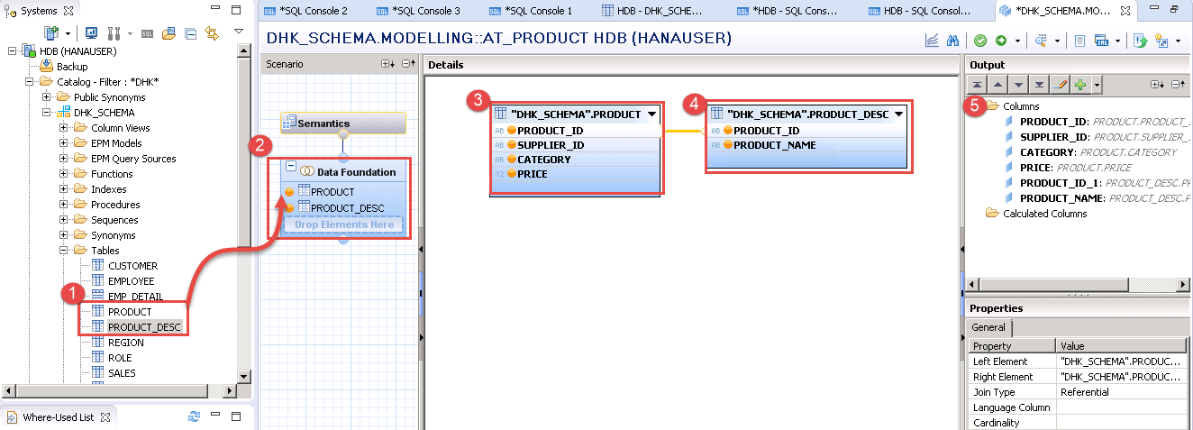
Attribute View
Attribute views provide descriptive data about the characteristics of data in your database. This is “master data” that defines things like hierarchies that describe relationships between data elements. By constructing attribute views, you create dimensions from which subsequent views can be constructed.

Slide 6
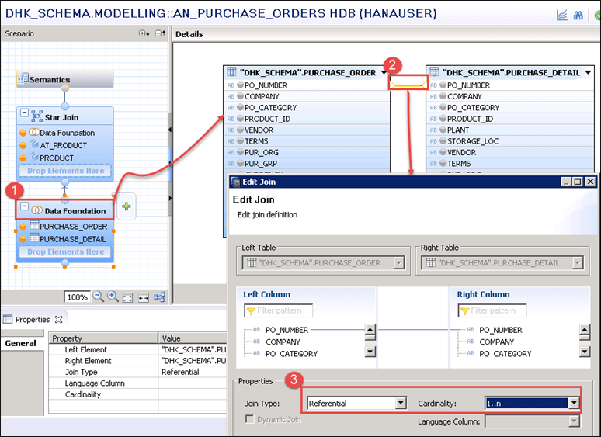
Analytic View
Analytic views in SAP HANA are optimized for aggregating mass data. Because the database is so fast, it’s not necessary to store aggregates in the database; rather, you aggregate on the fly in memory. Analytic views construct a central master “fact table” with key figures. You can use expressions, operators, and functions to analyze this data.

Slide 7
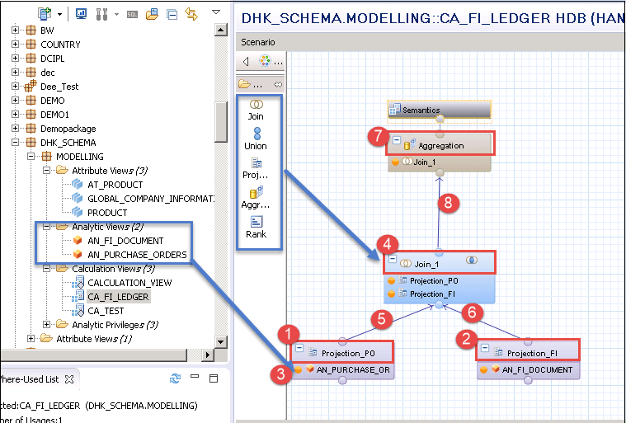
Calculation View
Calculation views provide a way to do flexible, complex logic in the database. They are built on top of one or more analytic or attribute views and allow you to do calculations after aggregation and grouping. Calculations are generally done after grouping at the attribute level and after aggregation at the analytic level.

Slide 8
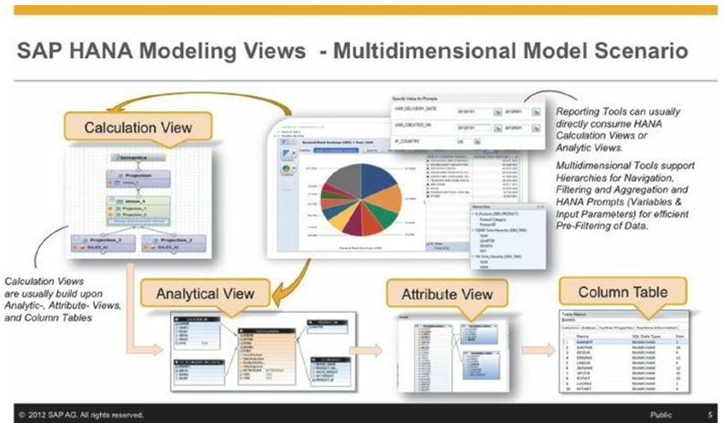

Slide 9

OIA Scenario Using Calculation View
Mr. Jems told about me to the CIO of the company last week on Christmas dinner. The CIO is very impressed by listening my stories how I helped Mr. Jems. Now he want me to help him as well.
He called me for a 1:1 meeting this morning. He was a secret task by the CEO of the co. Since quite a long time there were multiple escalations going on in co. for unpaid bills to their vendors and also customers who are unhappy due to unavailability of stocks.

Slide 10
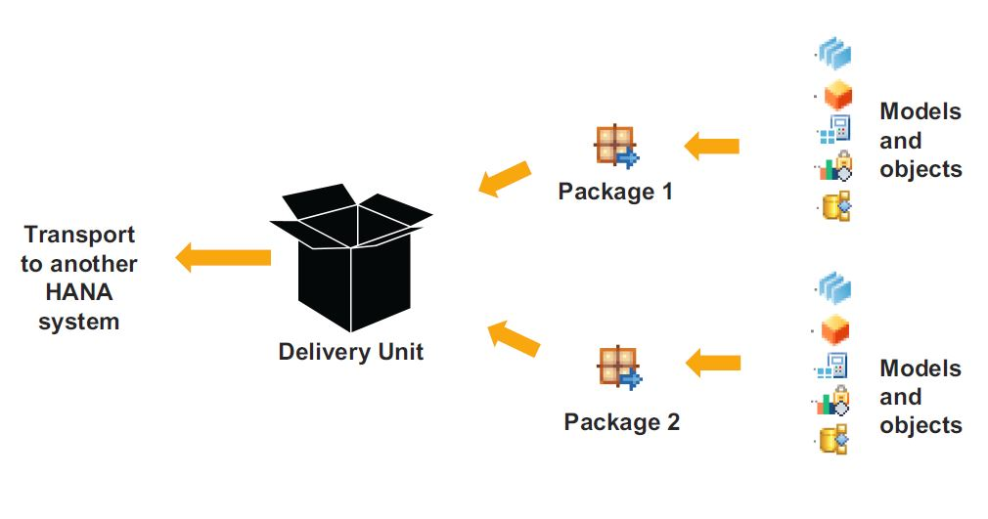
Concept of Delivery Unit
Delivery units are SAP HANA specific packages that can be used to install content, transport data models and applications developed on the SAP HANA platform. The delivery unit management window can be accessed through the 'Modeler Perspective' in SAP HANA Studio.

Slide 11

Break

Slide 12
How to Consume HANA Objects
< SAP NW 7.4
Side Car Scenario
SAP NW 7.4 SP2>
View Proxy
SAP NW 7.4 SP6>
Mr. X
ADBC
ABAP Database Connectivity
SAP offers built-in framework called ADBC framework which allows us to bypass the DB abstraction layer and directly communicate with underlaying DB. In this communication, we need to use Native SQL.
Pros
Allows all sorts of calls to DB
Native SQL
Only approach for lower NW
Cons
Too technical
Debugging is difficult
Error handling
View Proxy
We can use a proxy object in abap which allows us to point directly to the RUNTIME object of calculation view in HANA.
Is a DDIC view which is just a bridge to our HANA view. This is a bottom-up approach which means we can only create proxy if we have HANA view created already.
Pros:
Its easy
All kinds of HANA views using this
Cons:
Lifecycle is a challenge
Synchronization
Mr. X – ABAP CDS
It is a top down approach. No need to create views in HANA directly, in fact we don’t allow you to connect to HANA at all. You create me in ABAP system, activate me and I will create HANA view in HDB for you. You will get similar performance and additional benefits also.
Greatly simplifies lifecycle.
Caln View
active
HANA View
Notes:
The sole purpose of an R/3 system is to provide a suite of tightly integrated, large-scale business applications. R/3 comes prepackaged with the core business applications needed by most large corporations. These applications coexist in one homogenous environment. They are designed from the ground up to run using a single database and one (very large) set of tables.
Presentation: It is usually installed on a user's workstation. When started, the presentation server displays the R/3 menus within a window. This window is commonly known as the SAPGUI, or the user interface (or simply, the interface).
Basis : Basis is like an operating system for R/3. It sits between the ABAP/4 code and the computer's operating system. SAP likes to call it middleware because it sits in the middle, between ABAP/4 and the operating system. ABAP/4 cannot run directly on an operating system. It requires a set of programs (collectively called Basis) to load, interpret, and buffer its input and output. Basis provides the runtime environment for ABAP/4 programs.
Database: The database server is a set of executables that accept database requests from the application server. These requests are passed on to the RDBMS (Relation Database Management System). The RDBMS sends the data back to the database server, which then passes the information back to the application server. The application server in turn passes that information to your ABAP/4 program.

Slide 13
View Proxy
HANA Transport Container
ABAP Layer(Application Server)
ABAP Layer(Application Server)
Mr. X
Mr. X
HTC
ABAP Program
TRANSPORT
ABAP Program
View Proxy
View Proxy
Database Layer(HANA)
Database Layer(HANA)
HANA View
HANA View
Delivery Unit
active
DELIVERY UNIT
active
Caln View
HANA View
Caln View
HANA View

Slide 14
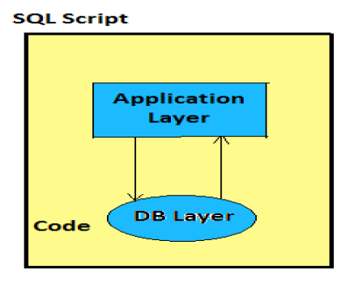
SQL Script
SQL script is a collection of extensions to the SQL (DML, DDL, DQL, DCL). The purpose is to give procedural capabilities to SQL. It allows developers to write data intensive logic inside of Core DB. This is one the best technique to squeeze performance out of HANA DB.
https://help.sap.com/viewer/product/SAP_HANA_PLATFORM/2.0.05/en-US?task=discover_task
https://help.sap.com/viewer/de2486ee947e43e684d39702027f8a94/2.0.05/en-US

Slide 15
Categories of SQL Script Code
Types of Statements
Declarative Logic
Data Flow Graph (Pure SQL Statements)
Imperative Logic
Orchestration Logic(IF, LOOPS, EXCEP, FOR, WHILE)
Code gets converted to Data Flow Graph
It has strong chances of getting executed in Parallel mode
Used for Complex logic
There is no parallel processing

Slide 16
Data Flow Logic
--Query 1
Lt_products = SELECT * FROM products WHERE cat = ‘Projectors’;
--Query 2
Lt_Sales = SELECT * FROM snwd_so WHERE productid IN (SELECT pid FROM :lt_products)
--Query 3
Lt_Purchase = SELECT * FROM snwd_po WHERE productid IN (SELECT pid FROM :lt_products)
--Query 4
SELECT sum(GROSS_AMOUNT) from :lt_sales;
What kick-out of parallel mode
Local variable or scalar parameters are used - DECLARE
Inside a processing block, system finds a DDL, DML statement
Encounter any imperative logic (IF, ELSE, FOR, …)
SQL statements which are not assigned to implicit variables
Guidelines
Split the code where the logic which cannot be processed in parallel mode
If possible, put all imperative logic at the end of your container
End
Query 4
Query 2
Query 3
Query 1

Slide 17
Containers in HANA
Which contains SQL Script code, Types of containers in HANA
Containers in HANA
Anonymous Block
Stored Procedure
User Defined Functions (UDF)
Test, put a code for One–time execution
Requires a compilation every time you run
DO BEGIN
--- SQL Script Coda
END;
Compile and Store and use again and again
Can have IN, INOUT, OUT multiple params
CREATE PROCEDURE procname (IN p1 type, OUT p2 type, INOUT p3 type)
LANGUAGE SQLSCRIPT DEFAULT SCHEMA schema name
READS SQL DATA AS BEGIN
--SQL Script Coda ☺
END;
Scalar UDF
10,’anubhav’
Table UDF
Complex
A function always and always return exactly one value.
We can have multiple input
Depending on return type
CREATE FUNCTION funcname(p1 type)
DEFAULT SCHEMA schema
AS BEGIN
END;

Slide 18
Faunda Fox on SQL Script
SQL Script is not case-sensitive like ABAP.
Every statement in SQL Script ends with semi-colon ( ; )
When we create variables in SQL Script they are assigned NULL value and any operation with NULL becomes NULL
The = is a comparison operator and := is an assignment operator
When we assign value to a variable we use direct variable name but when we want to use the variable in some operations we use :variable (: is value of operator) ☺
Declare x integer; declare y integer; declare z integer;
x := 10; y := 20; z = :x + :y;
We always tries to push data intensive logic using SQL Script in HANA database.
Since we work with DB level directly, we need to take care of client handling.

Slide 19
Feedback
AnubhavTrainings.com :
https://www.anubhavtrainings.com

Slide 20
End of Day 4

Slide 21

Questions

Slide 22

Anubhav Oberoy

